Slide 1
Egad! It’s Excel
Day 2
The Data Bootcamp

Slide 2
Admin Stuff

Slide 3


Instructor = … ?
Jacob Deming
Started out in PR and Marketing for media companies
Independent game developer for a few years after that
Over 5 years data wrangling (with A TON of experience being a n00b at it)
First Curriculum Engineer for Trilogy Education Services
Wrote large portions of both the FSF and Data Viz curriculum taught today
YOUR PHOTO
GOES HERE

Slide 4

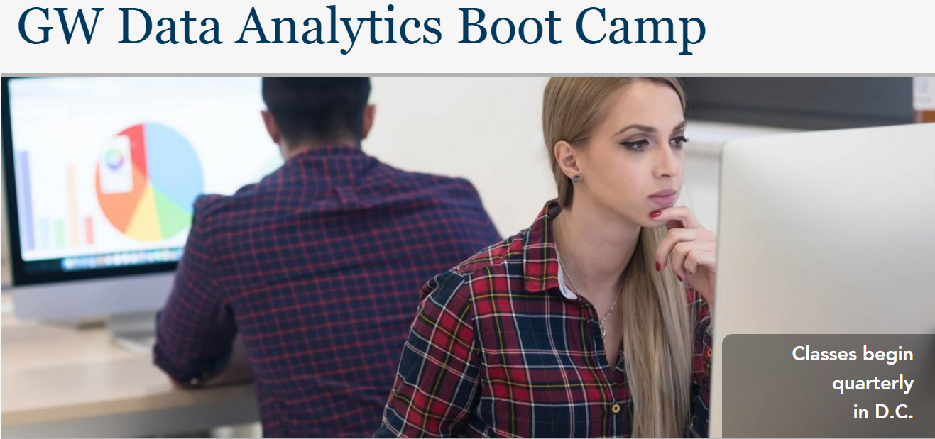

Things I’ve Worked On…
AND SO MANY MORE PROGRAMS ACROSS THE NATION…
Cool Data Project You’ve Worked on Goes Here

Slide 5
Why We Teach… Data Analytics

Slide 6
Why We Teach… Data Analytics

Slide 7

Why We Teach… Data Analytics

Slide 8
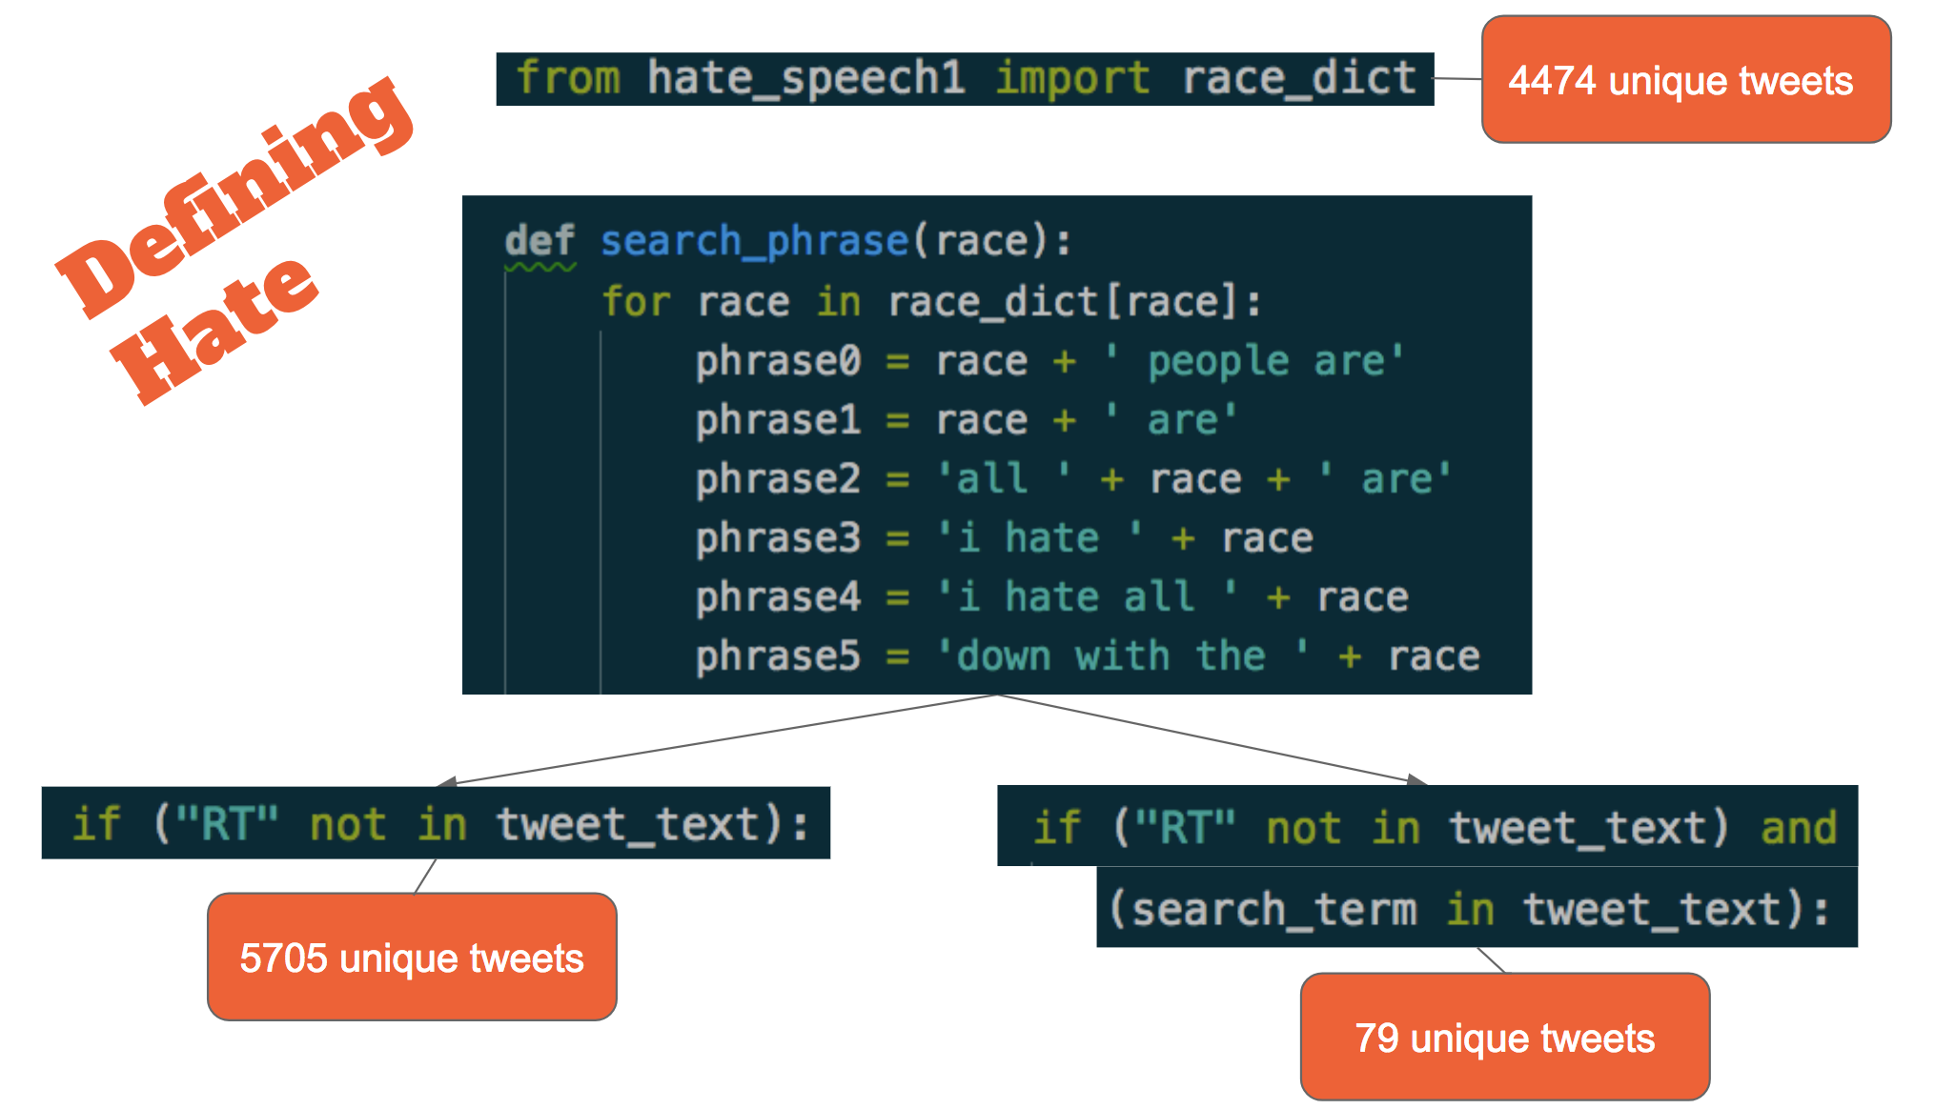

Why We Teach… Data Analytics
Hatin’ on Twitter
Students automated a process for scanning Twitter for observable signs of hate speech, then used it to analyze over 3,000 tweets to identify patterns in user networks, location, and statewide demographics.
Technologies: Python Pandas, Twitter API, Tweepy, Matplotlib

Slide 9
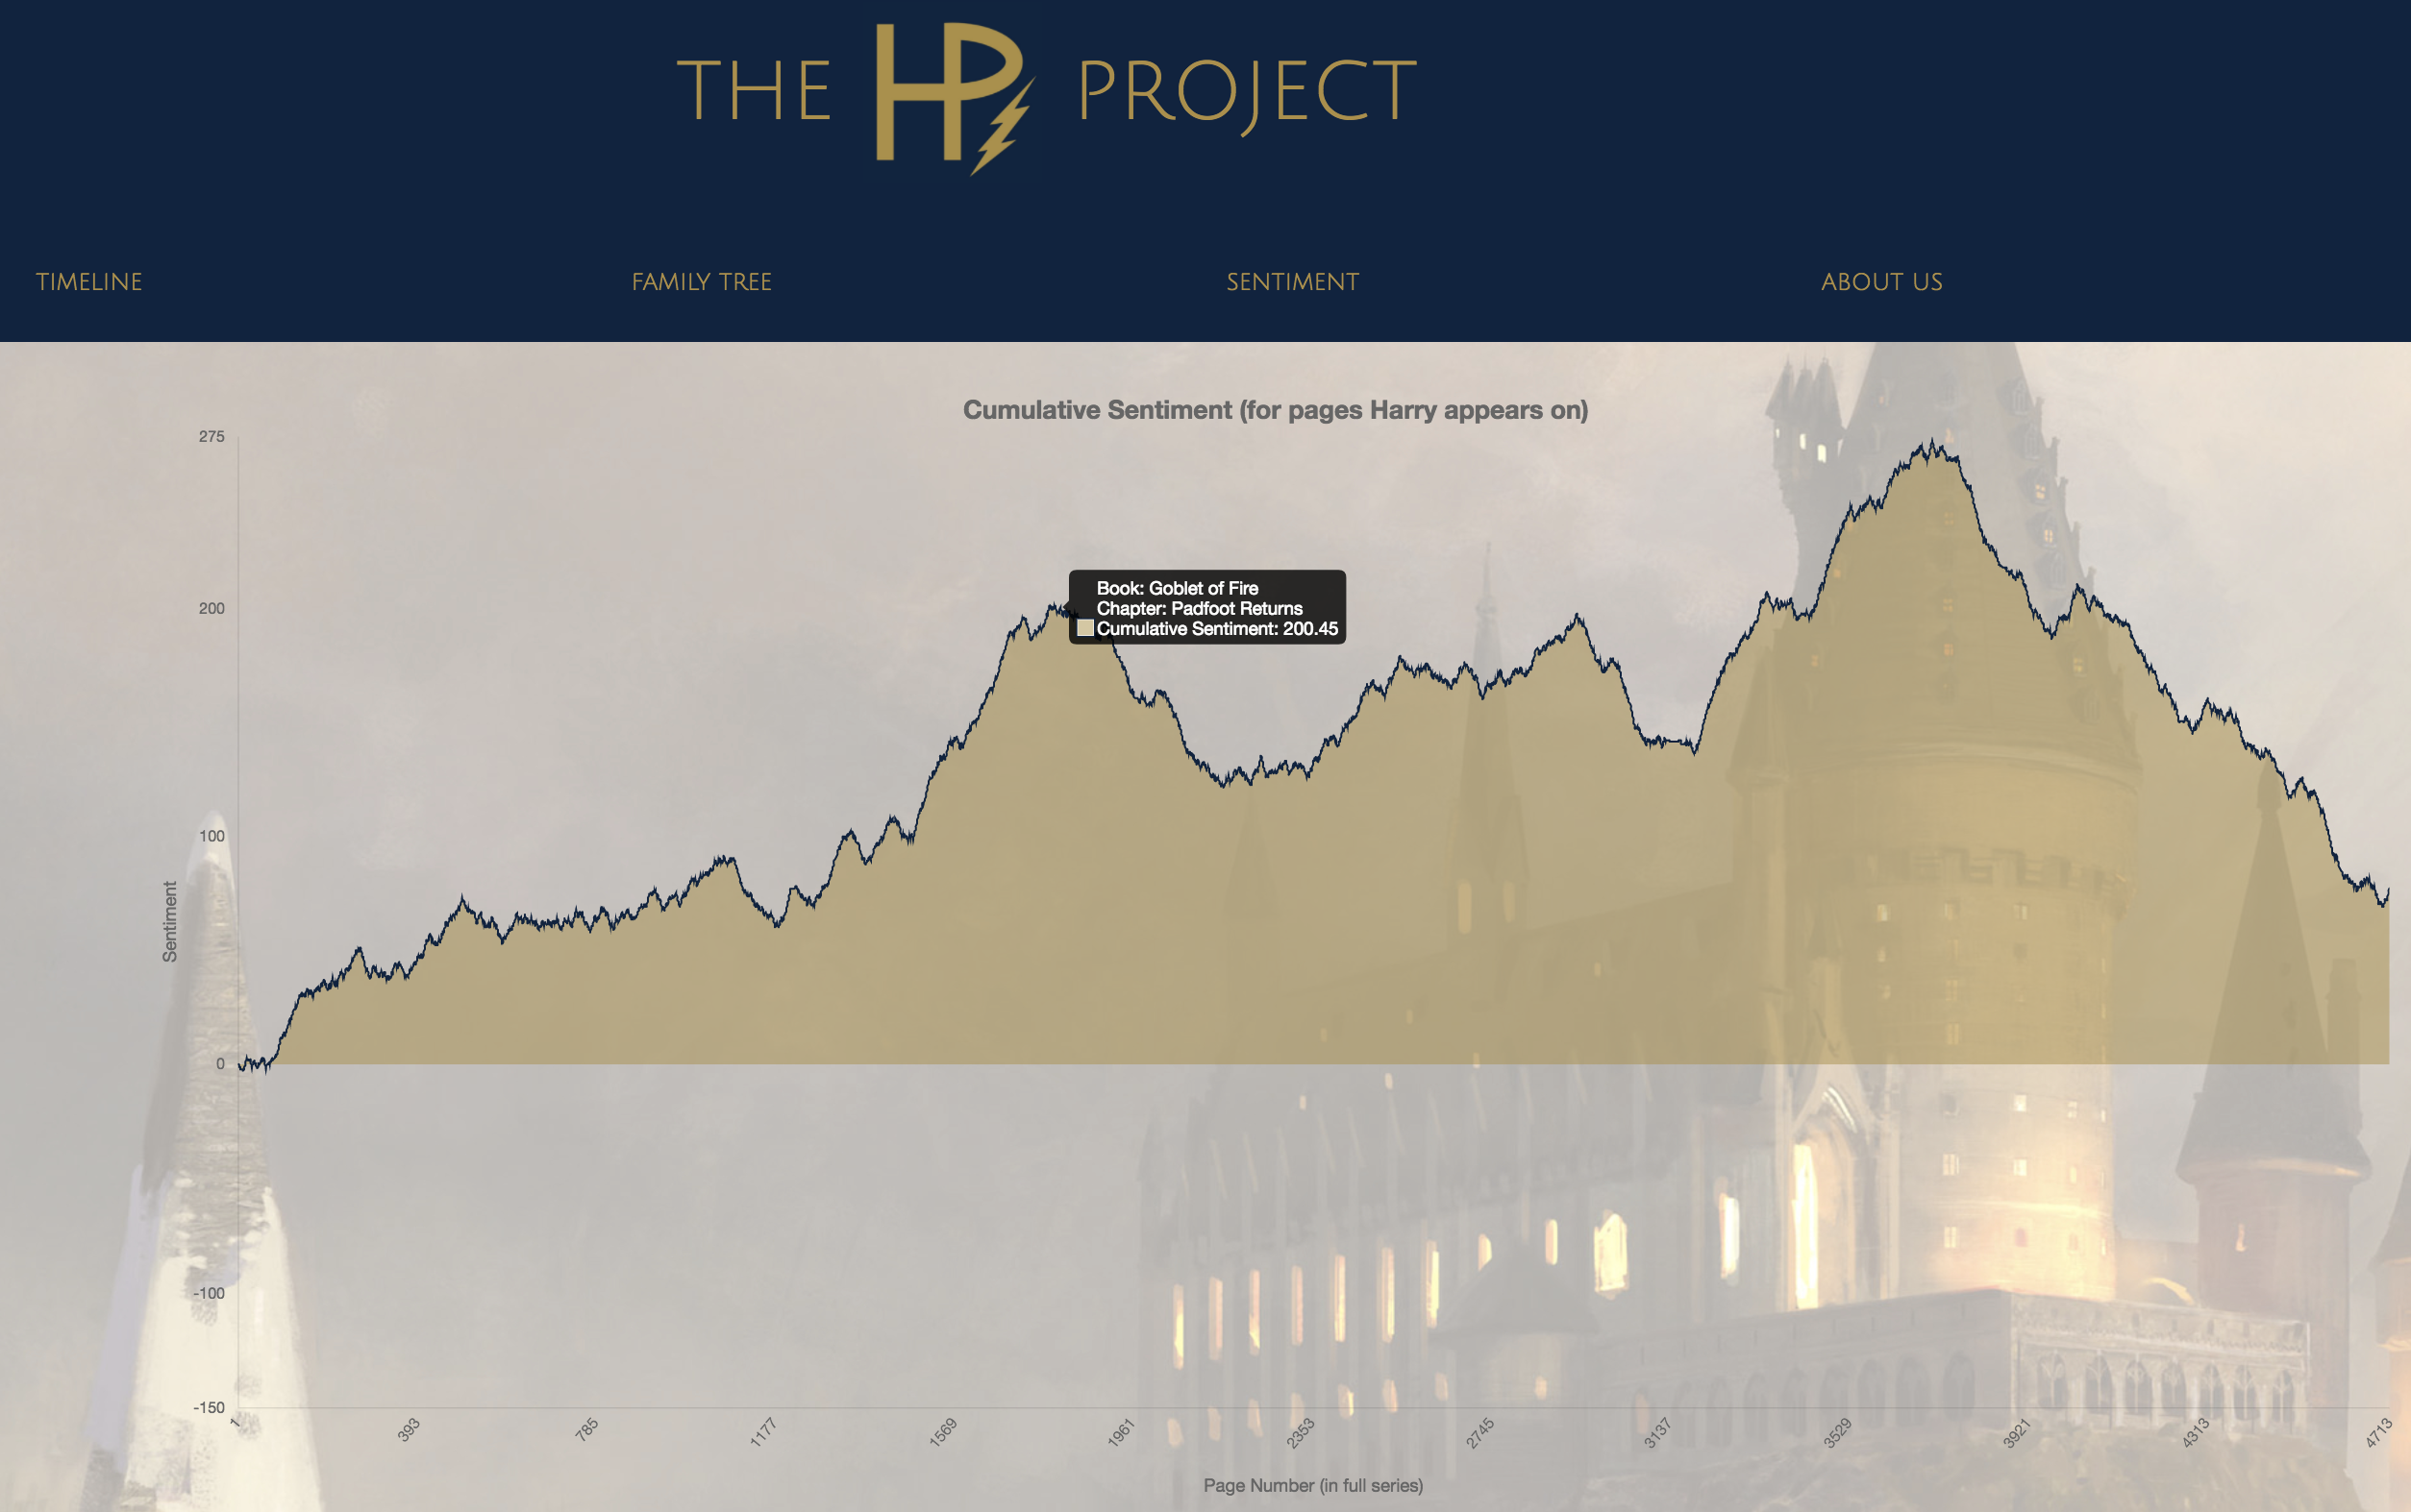
Why We Teach… Data Analytics
The HP Project:
Students used a combination of web scraping, data visualization, and natural language processing to plot the changing sentiment of text as characters progressed.
Technologies: D3.js, Beautiful Soup, RegEx, Python Pandas, HTML/CSS

Slide 10
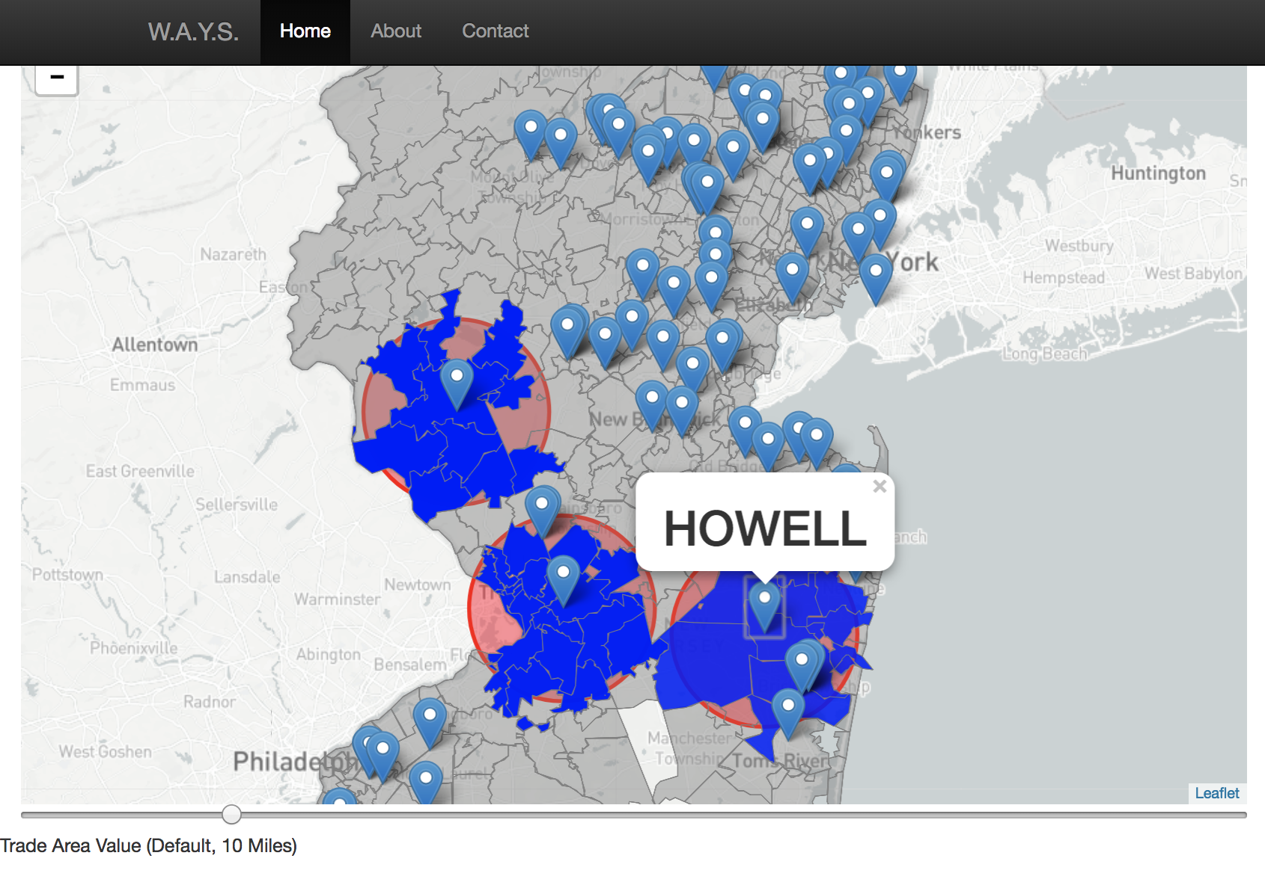
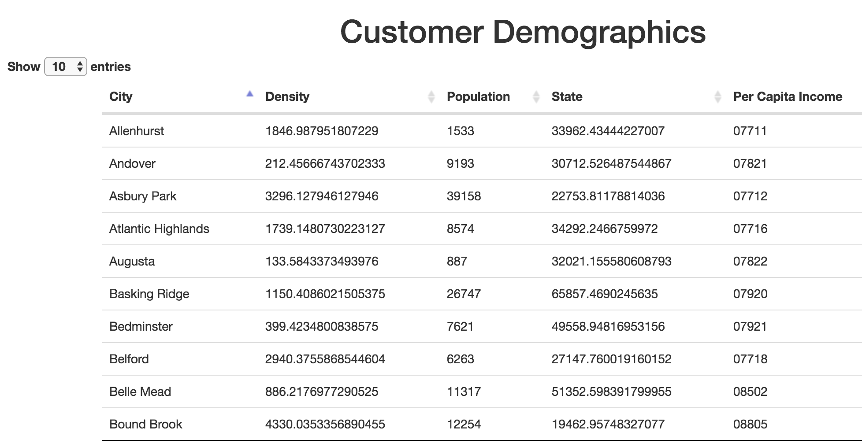
Why We Teach… Data Analytics
W.A.Y.S
Students used real data from Bed Bath and Beyond along with their newfound skills in map-based visualizations to build an interactive customer demographic explorer.
Technologies: Leaflet.js, HTML/CSS, Flask, SQL, JavaScript, jQuery

Slide 11


Why We Teach… Data Analytics
Bitcoin Forecasting Model:
Students used historic S&P and Bitcoin pricing data along with an assortment of machine learning algorithms including the new Facebook Prophet to identify pricing predictions based on trailing data.
Technologies: Python Pandas, Scikit Learn, Facebook Prophet

Slide 12

Example Project: ML Powered Beer Recommendations
BEER-RCOMMDNER
Helps consumers pick their next favorite beer through the power of machine learning!

Slide 13
The “Data” Behind the Data Story
There is absolutely a student just like YOU that has succeeded in this program. You can too.

Slide 14
Just a Few More Details…

Slide 15
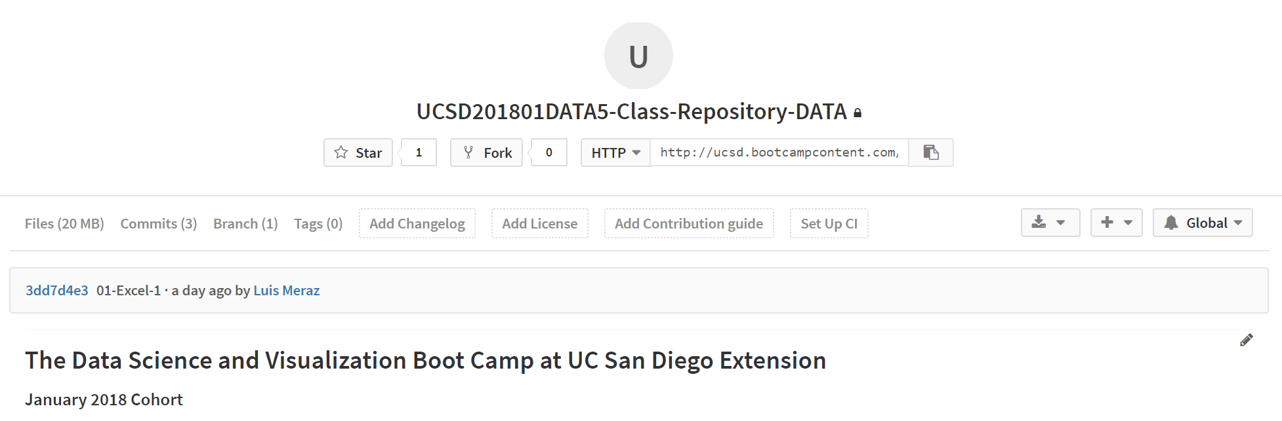
Class Git Repository
All Class Content and Homework will be here:
http://ucsd.bootcampcontent.com/UCSD-Coding-Bootcamp/UCSD201801DATA5-Class-Repository-DATA

Slide 16
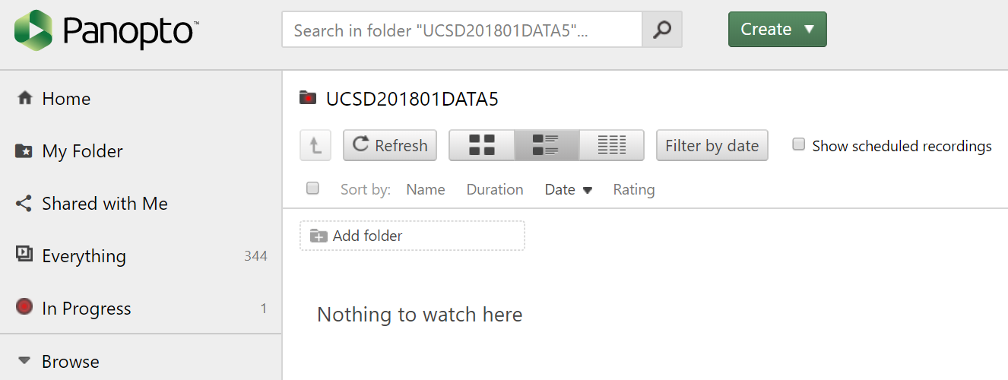
Class Panopto Videos
All class videos will be hosted here:
https://codingbootcamp.hosted.panopto.com/Panopto/Pages/Sessions/List.aspx#folderID=%22f38058c4-d0f3-4191-82bf-a88301290f0c%22&folderSets=3

Slide 17
Quick Refresher

Slide 18
Data Science is about what two things?

Slide 19
Truth-Telling & Story Telling

Slide 20
What are the steps in the Analytics Paradigm?

Slide 21
Analytics Paradigm
Decompose the Ask
Identify Data Sources
Define Strategy and Metrics
Build Data Retrieval Plan
Retrieve the Data
Assemble and Clean
Analyze for Trends
Acknowledge Limitations
Make the Call or
Tell the Story
Regardless of type or industry, this paradigm provides a repeatable pathway for effective data problem solving.

Slide 22
Let’s Start with the Basics

Slide 23
Formulas

Slide 24
Ooh… Coding! (Sort Of)
Function
=
SUM(
1, 2, 3
)
Arguments
In a way, Excel has introduced you to a sort of proto-programming. Throughout your time writing scripts you will rely on functions (methods) that do something to or with arguments.

Slide 25
Ooh… Coding! (Sort Of)
Function
=
AVG(
F4:F6
)
Variable Arguments
When we reference a set of range, Excel is being given a set of variable inputs. It will determine the actual values of these inputs prior to executing the function.

Slide 26
Ooh… Coding! (Sort Of)
What about this example?
Which is the function? Which are the arguments?
= SUM( AVG(F4:F6), AVG(G4:G6) )

Slide 27
Ooh… Coding! (Sort Of)
What about this example?
Which is the function? Which are the arguments?
= SUM( AVG(F4:F6), AVG(G4:G6) )
It Depends…

Slide 28
Ooh… Coding! (Sort Of)
What about this example?
Which is the function? Which are the arguments?
= SUM( AVG(F4:F6), AVG(G4:G6) )
The AVG functions takes as their arguments the ranges provided.

Slide 29
Ooh… Coding! (Sort Of)
What about this example?
Which is the function? Which are the arguments?
= SUM( AVG(F4:F6), AVG(G4:G6) )
This is a nested function. We’ll be doing plenty of complex nests in this class.

Slide 30
Demo Time! (01-ExcelPlayground, 02-NamedRanges)

Slide 31
Conditionals

Slide 32
Conditionals: If This… Then That
Step 2a
If criteria is met…
Step 1
If criteria is not met…
Step 2b
Conditionals present a way to control the flow of logic based on certain criteria being met. This is a core building block in all languages.

Slide 33
Conditionals: If This… Then That
Set Cell to True
If D2 > 5
Determine D2’s Value
If D2 <=5
Set Cell to False
=IF(D2>5,TRUE,FALSE)

Slide 34
But what if… we wanted to combine conditions?

Slide 35
AND, NOT, OR

Slide 36
Conditionals: If This… Then That
=IF(AND(D2>5, D2<10),TRUE,FALSE)

Slide 37
Conditionals: If This… Then That
Set Cell to True
If D2 > 5 AND D2 < 10
Determine D2’s Value
If D2 <=5 OR D2 >= 10
Set Cell to False
Nesting conditionals can quickly become a very convoluted (albeit necessary) part of your data prep.

Slide 38
Demo Time! (03-ColorCounter – 08-McDonalds)

Slide 39
BREAK

Slide 40
Pivot Tables

Slide 41
Get Pivot With It
Pivot Tables are one of the most important data visualization concepts to master in this class.
(Don’t worry. They are a cinch to deal with)

Slide 42
Get Pivot With It
Seller | Qty. Sold | Date
Joseph | $42.50 | 1/1/17
Jacob | $65.00 | 1/3/17
Jacob | $5.25 | 1/6/17
Joseph | $125.00 | 1/6/17
Jacob | $3.50 | 1/7/17
Matt | $32.00 | 1/9/17
Seller | Total Sold
Joseph | $167.50
Jacob | $73.75
Matt | $32.0
In essence, Pivot tables are a summative analytic tool that allows us to perform aggregate functions that along any combination of fields.
(The name comes from the fact that we are pivoting along a data axis)

Slide 43
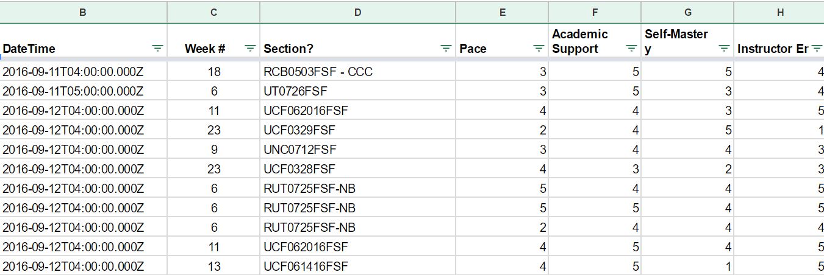
Words to the Wise – Keep It Flat!
Modern BI tools like Tableau, Sisense, and Salesforce work best if data is stored in flat CSVs – meaning column headers represent fields (vertically) on the spreadsheet. This is largely because all of these technologies heavily utilize Pivot Tables beneath their visualizations.
Don’t try to confuse this simplicity. “Spreadsheet magic” is a nightmare to analyze.

Slide 44
Demo Time! (09-PivotTables, 10-TopSongs)

Slide 45
Lookups

Slide 46
Look It Up with Lookups
Planet | Population
Zeelo | 5020
Merinoa | 380
Cardboard Box | 2
… | …
Asteroid 9 | 95
Assume this table is gigantic…
How would we retrieve the population of a specific planet for use in another formula?

Slide 47
Look It Up with Lookups
Planet | Population
Zeelo | 5020
Merinoa | 380
Cardboard Box | 2
… | …
Asteroid 9 | 95
Assume this table is gigantic…
How would we retrieve the population of a specific planet for use in another formula?
=vlookup( <value>, <full table>, <column to retrieve>)

Slide 48
What Will This Yield?
Planets
Planet | Population | Species
Zeelo | 5020 | Zoltans
Merinoa | 380 | Murphies
Cardboard Box | 2 | Hambones
… | …
Asteroid 9 | 95 | The Asterisks
=vlookup( “Asteroid 9”, Planets, 3)

Slide 49
What Will This Yield?
Planets
Planet | Population | Species
Zeelo | 5020 | Zoltans
Merinoa | 380 | Murphies
Cardboard Box | 2 | Hambones
… | …
Asteroid 9 | 95 | The Asterisks
=vlookup( “Astroid 9”, Planets, 3)
The Asterisks

Slide 50
Demo Time! (11-Lookups, 12-ProductPivot)

Slide 51
Questions / Discussion
Notes:
It’s important to keep in mind why you joined this class. Let’s talk about your goals.

